Slide 1
MRA Project ML 1
Priyadharshini K
PGP – DSBA Nov-C Batch, 2021
kpriyadharshinik@gmail.com
Tableau Public Link
https://public.tableau.com/views/MRA_16325905246800/Sheet1?:language=en-US&:display_count=n&:origin=viz_share_link

Slide 2
Agenda [Table OF CONTENT]
Problem Statement
Executive Summary
EDA
EDA Summary
RFM
RFM Summary

Slide 3
PROBLEM STATEMENT
An automobile parts manufacturing company has collected data of transactions for 3 years. They do not have any in-house data science team; thus, they have hired you as their consultant. Your job is to use your magical data science skills to provide them with suitable insights about their data and their customers.
This project aims to find the underlying buying patterns of the customers of an automobile part manufacturer based on the past 3 years of the Company's transaction data and hence recommend customized marketing strategies for different segments of customers.
ABOUT DATA
The dataset has a total of datetime64(1), float64(2), int64(5), object(12) datatypes. The dataset has categorical, continuous and discrete data.
Shape of the dataset: (2747,20)
No duplicate values are present in the dataset.
Null values/missing values are not present in the dataset.
Object Datatype variables – STATUS, PRODUCTLINE, PRODUCTCODE, CUSTOMERNAME, PHONE, ADDRESSLINE1, CITY, POSTALCODE, COUNTRY, CONTACTLASTNAME, CONTACTFIRSTNAME, DEALSIZE
Int Datatype variables – ORDERNUMBER, QUANTITYORDERED, ORDERLINENUMBER, DAYS_SINCE_LASTORDER, MSRP
Float Datatype variables Discrete variable – PRICEEACH, SALES

Slide 4
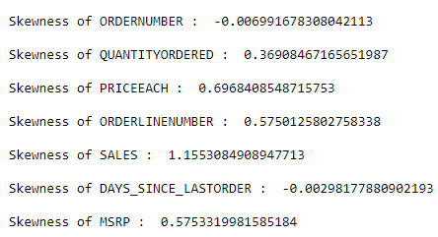
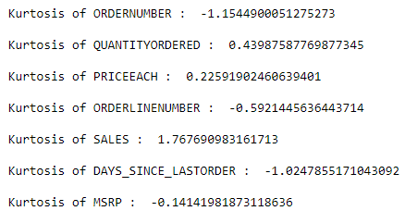
EDA - Univariate Analysis Tool Used: Python
Skewness
Kurtosis
Skewness is a measure of symmetry, or more precisely, the lack of symmetry.
For skewness, if the value is greater than + 1.0, the distribution is right skewed.
If the value is less than -1.0, the distribution is left skewed. Skewness of the variables present in the dataset is between -0.5 to 0.5, indicates that the data is symmetrical.
Sales - Right skewed
MSRP, Quantity ordered, order number, days since last order - Symmetrical
Kurtosis is a measure of whether the data are heavy-tailed or light-tailed relative to a normal distribution. Data sets with high kurtosis tend to have heavy tails, or outliers. Data sets with low kurtosis tend to have light tails, or lack of outliers.
For kurtosis, the general guideline is that if the number is greater than +1, the distribution is too peaked. Likewise, a kurtosis of less than –1 indicates a distribution that is too flat.
Quantity ordered, Price each , MSRP - follows relative normal distribution
Sales - Heavy tailed towards left

Slide 5
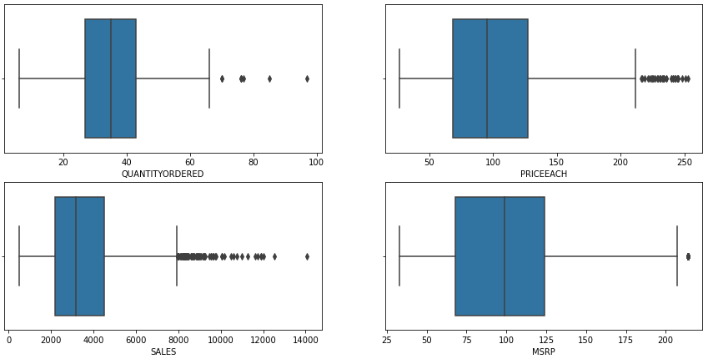
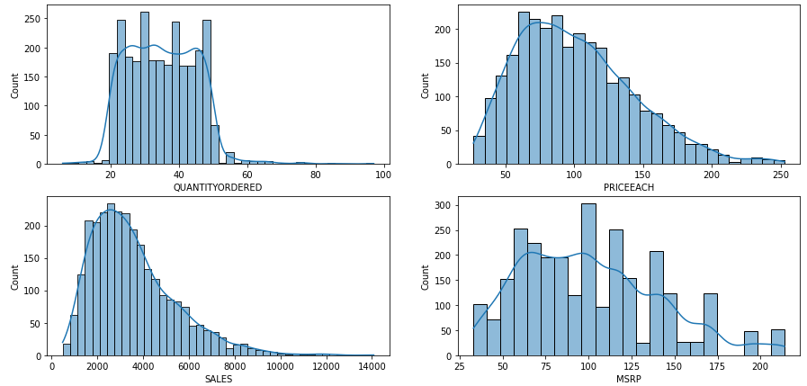
EDA - Univariate Analysis Tool Used: Python
Box Plot
Histogram
Outliers are present in the dataset.
Sales, Price each, Quantity ordered, MSRP variable is normally distributed.

Slide 6
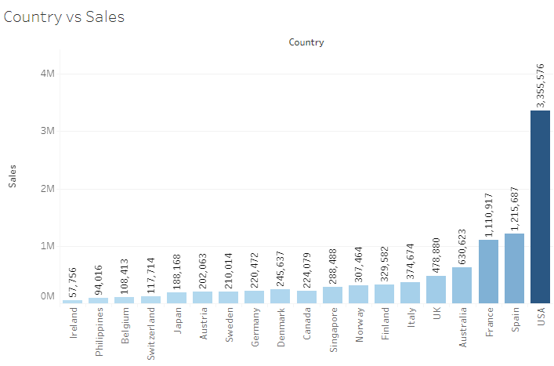
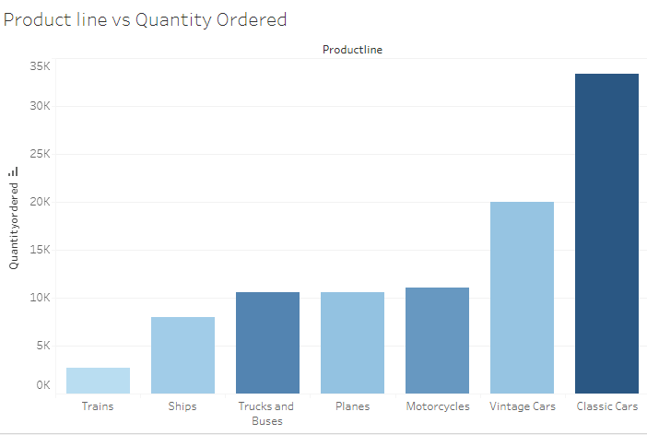
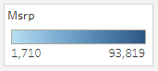
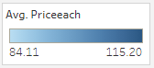
EDA - Multivariate Analysis Tool Used: Tableau
USA ranks first in terms of Sales and MSRP followed by Spain, France, Australia and UK in top 5 places.
Classic Cars tops most in terms Quantity ordered.

Slide 7
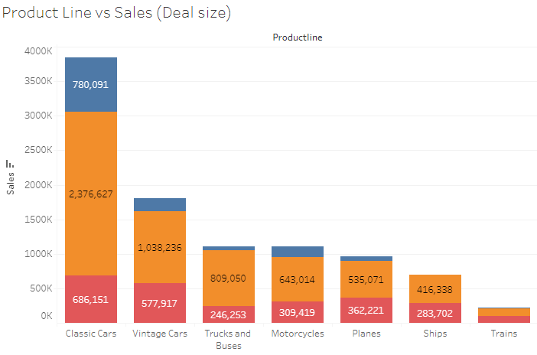
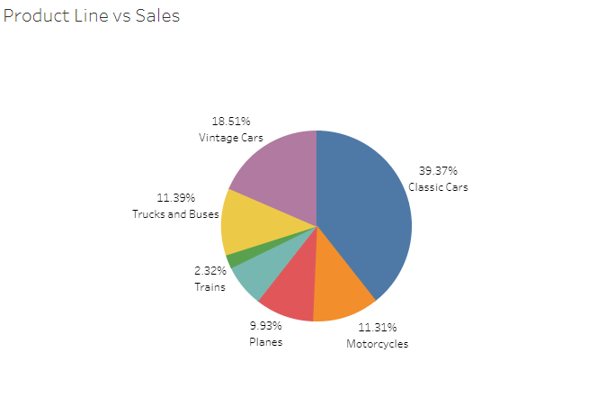
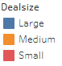
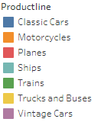
Classic Cars tops first in terms of Sales, followed by Vintage cars and Trucks/Buses with predominant Medium size deals.
Classic Cars contributes to about 40% of the total sales with trains being minimum with 2%

Slide 8
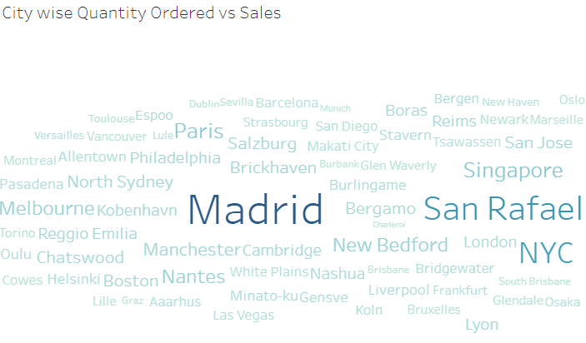
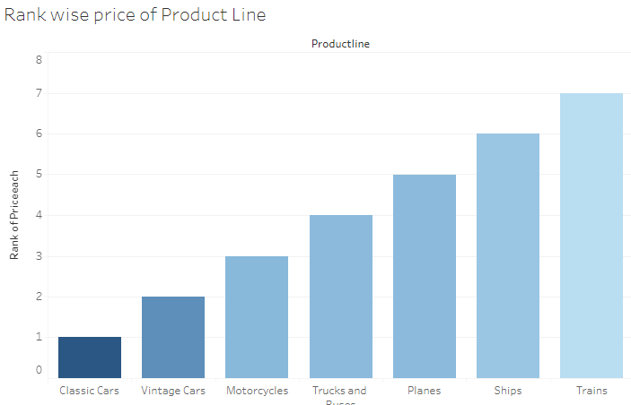
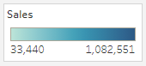
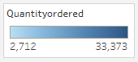
Madrid tops Quantity Ordered, and Sales followed by San Rafael and NYC.
Price of Classic cars is the minimum, but Quantity ordered for Classic cars is the maximum with Trains being costliest with minimum order quantity.

Slide 9
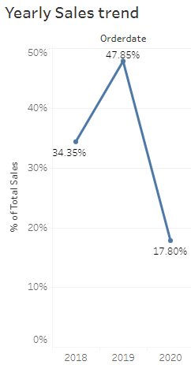
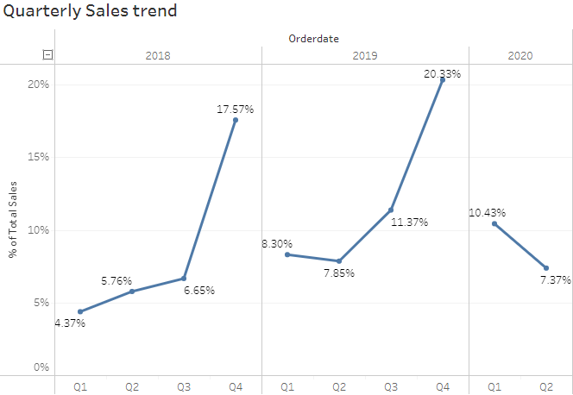
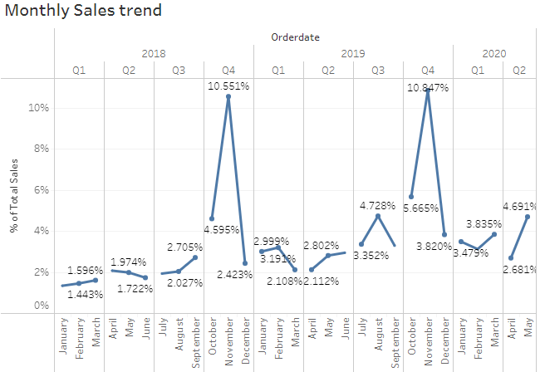
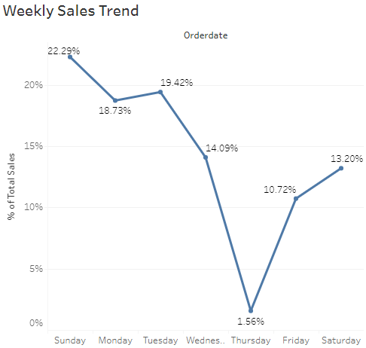
Weekly, Monthly, Quarterly, Yearly Trends in Sales
Yearly : 2019 has recorded the max. sales (47% of Total Sales.)
Quarterly : Q4 has the maximum sales with Q1 minimum.
Monthly : November month has the peak Sales
Weekly : Sunday records the max. sales (22%) while Thursday records minimum sales (1%)

Slide 10
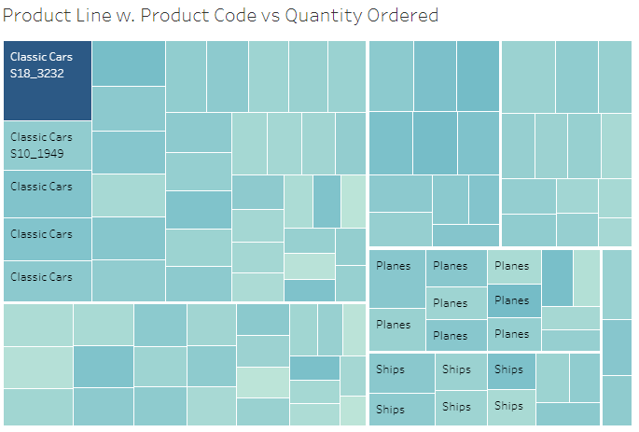
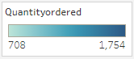
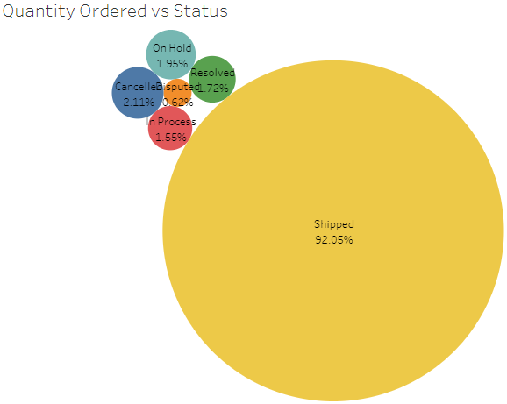
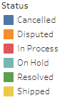
Classic Cars with Product code S18_3232 has the maximum Quantity ordered
Only 92% of the total orders get shipped, while 2 % of orders get cancelled.

Slide 11
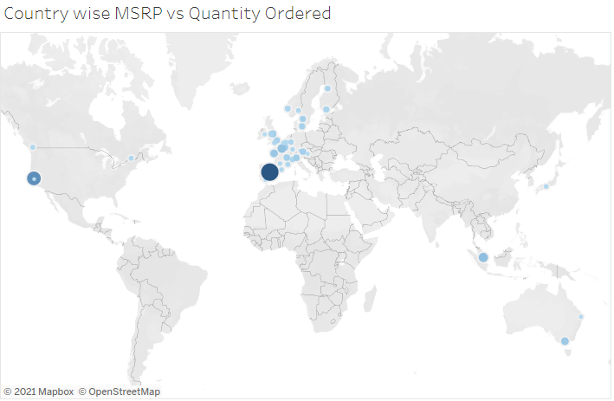
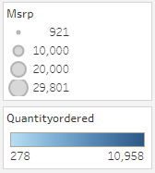
Spain has the maximum of Quantity ordered, maximum MSRP

Slide 12
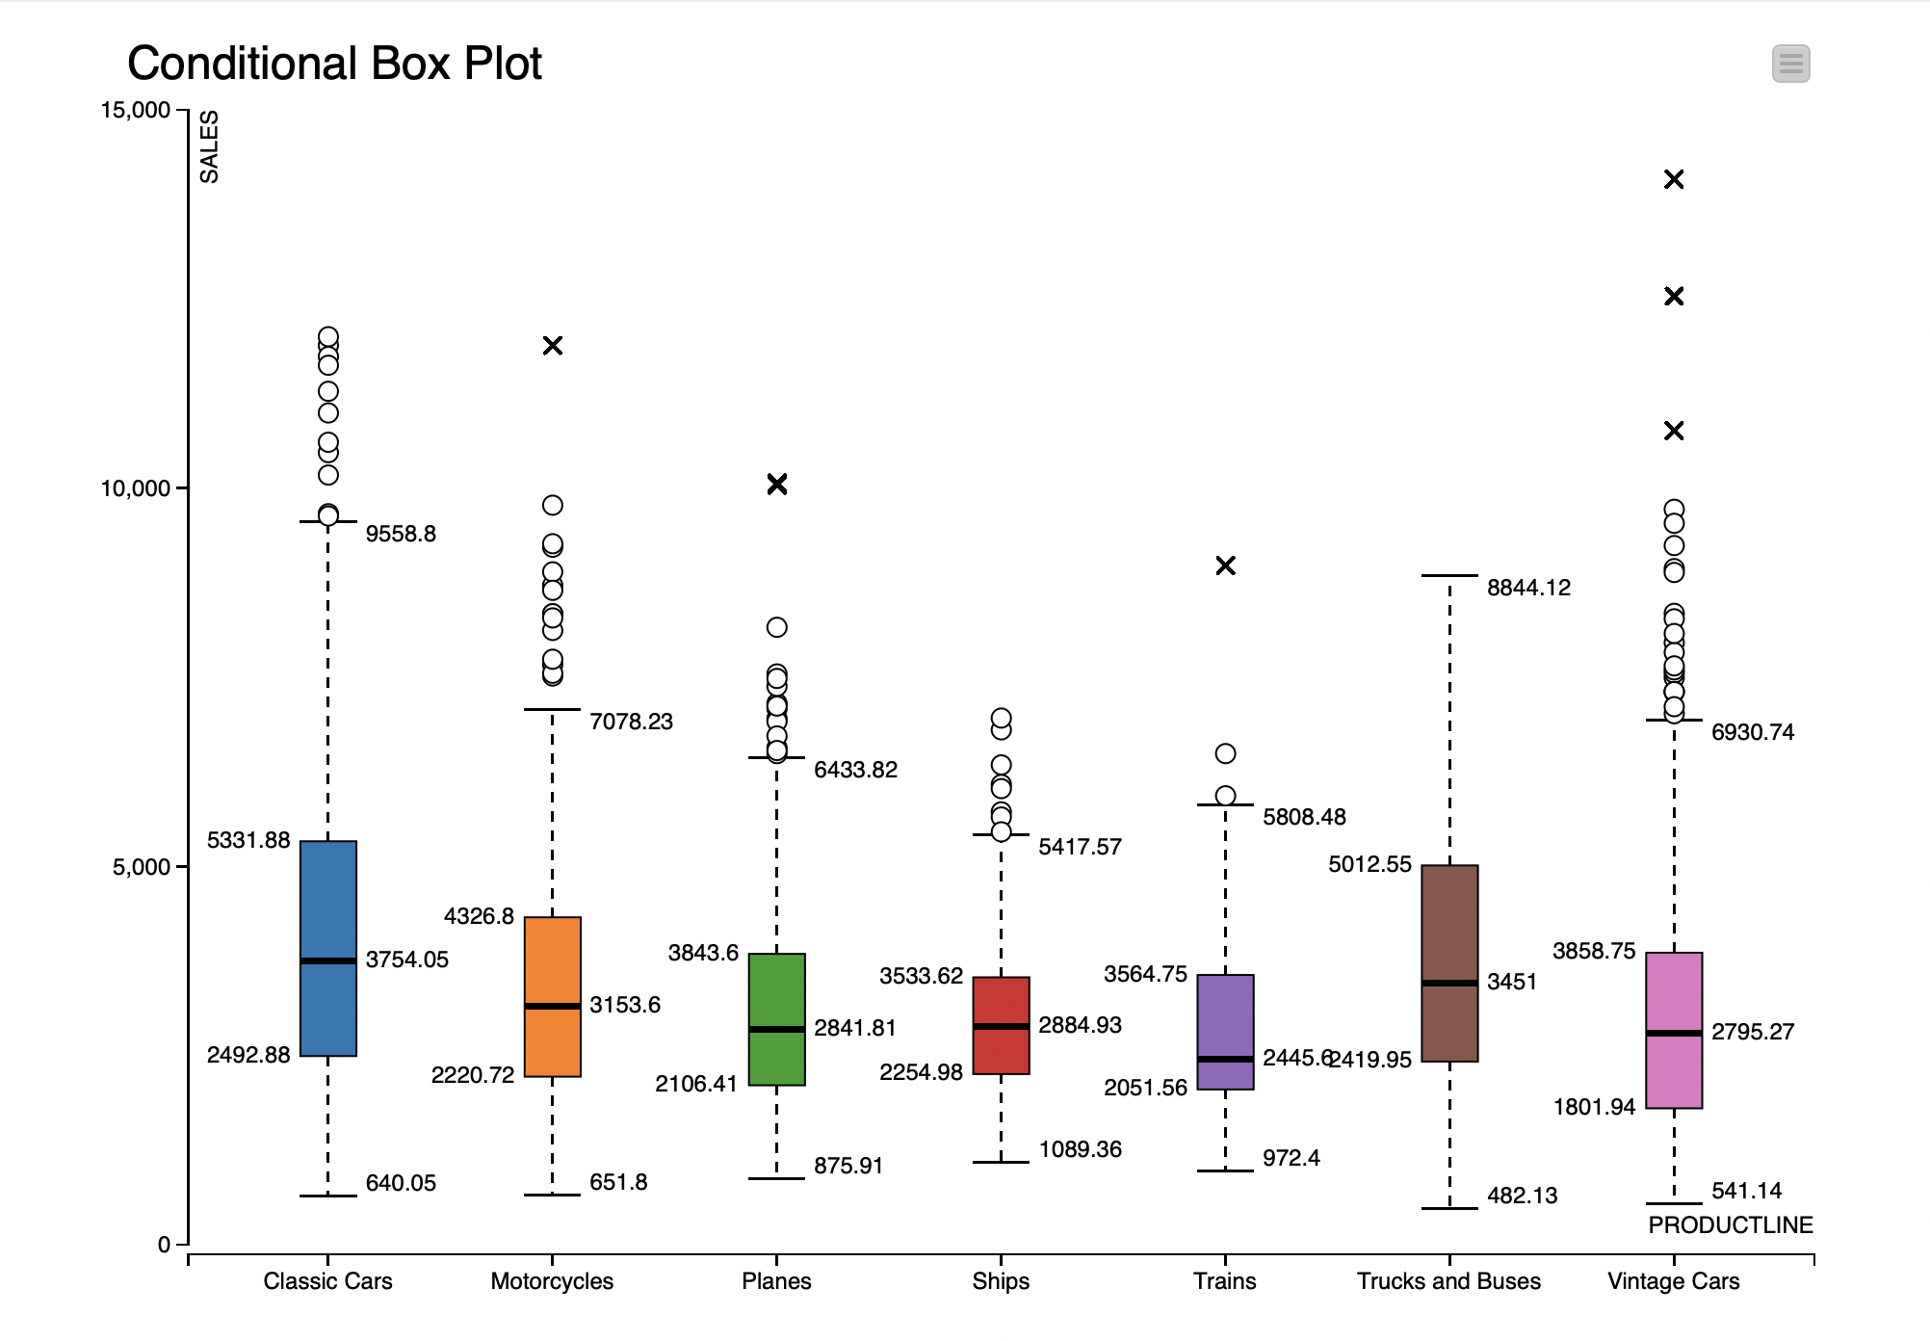
EDA IN KNIME

Slide 13
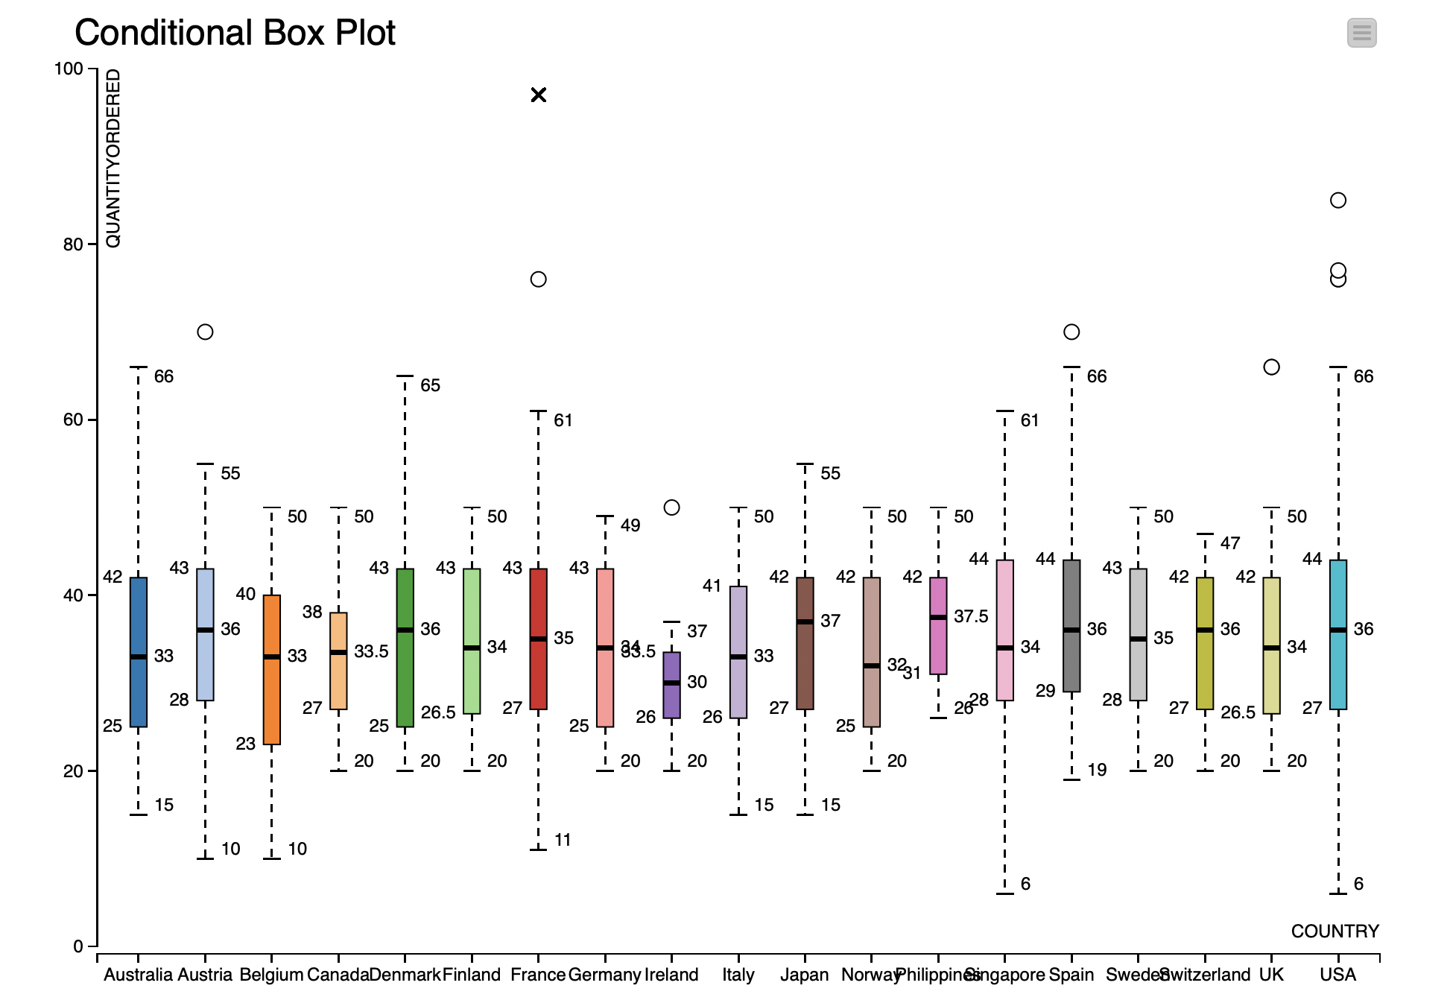
EDA IN KNIME

Slide 14
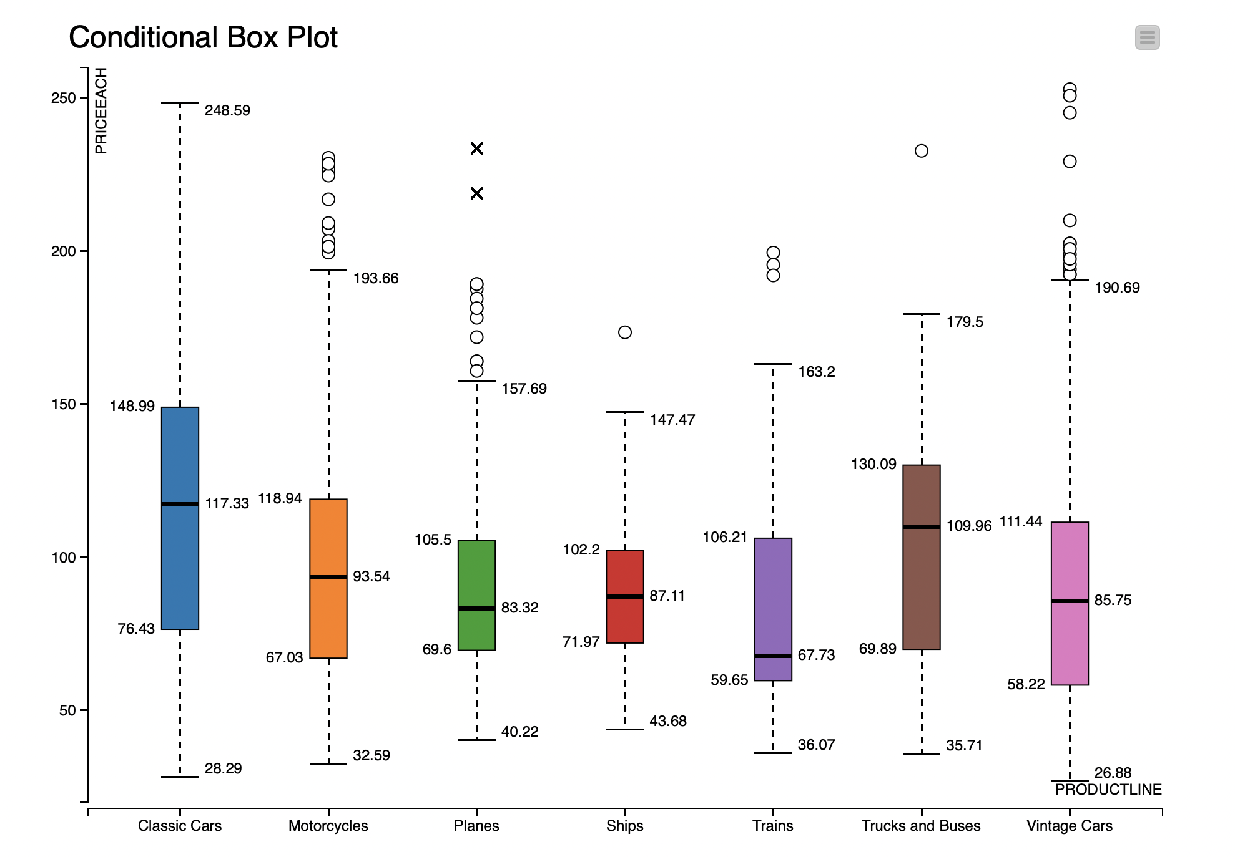
EDA IN KNIME

Slide 15
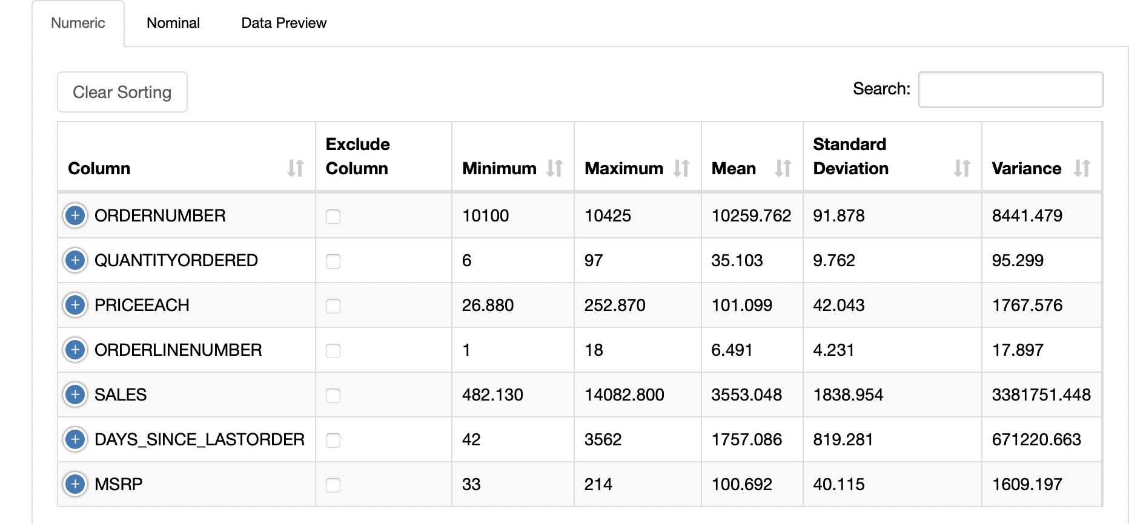
EDA IN KNIME

Slide 16
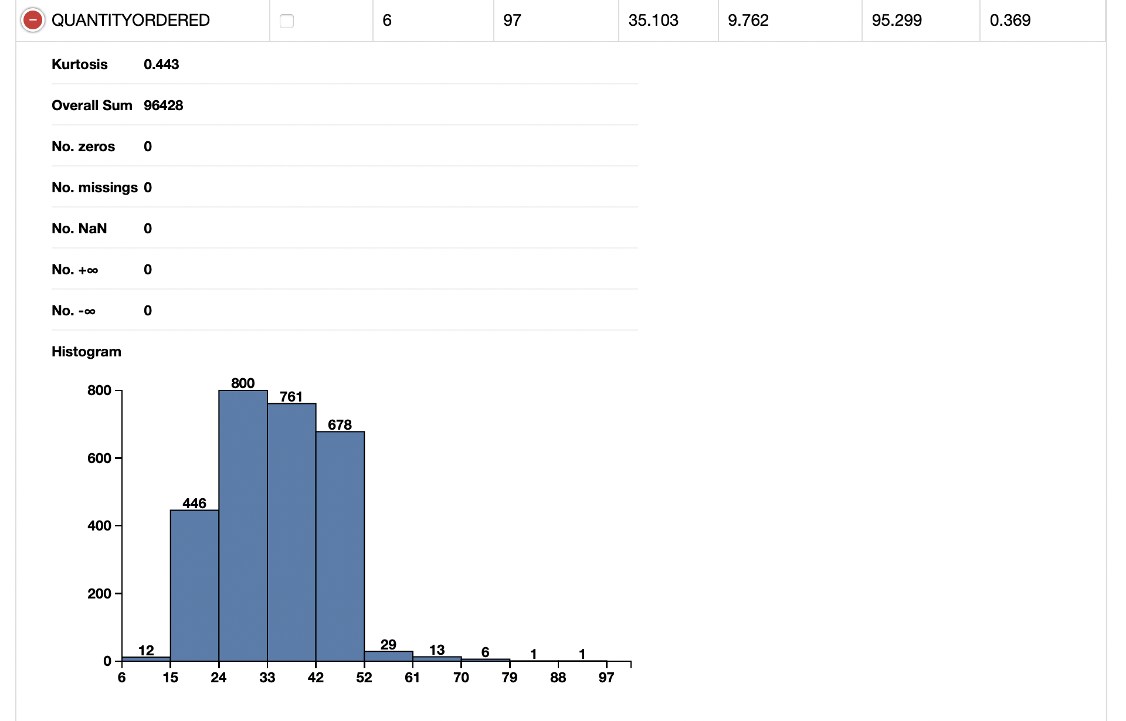
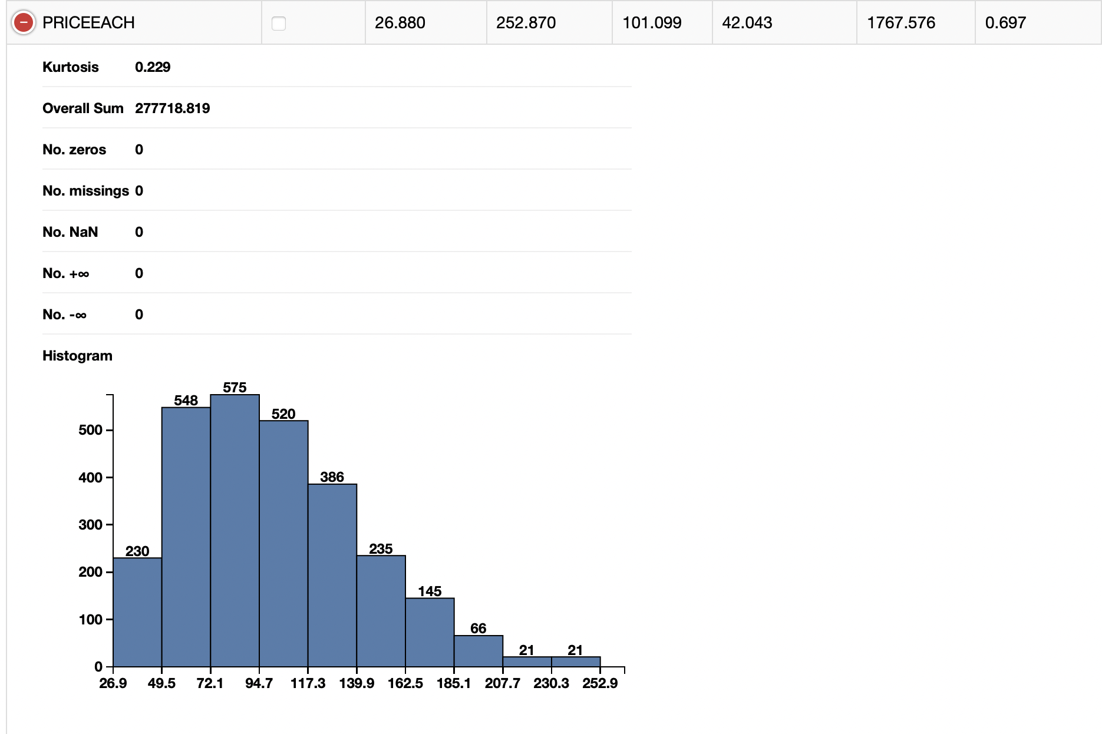

Slide 17
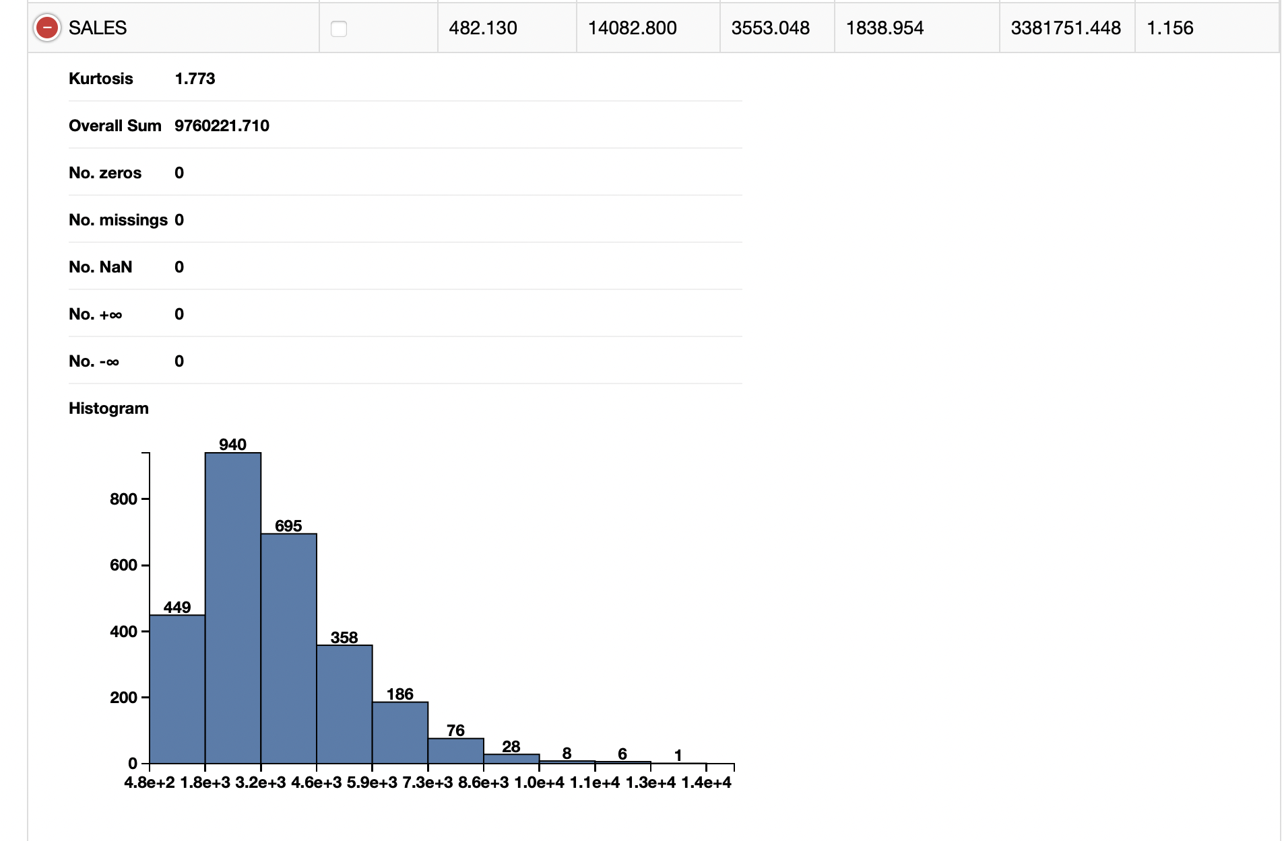
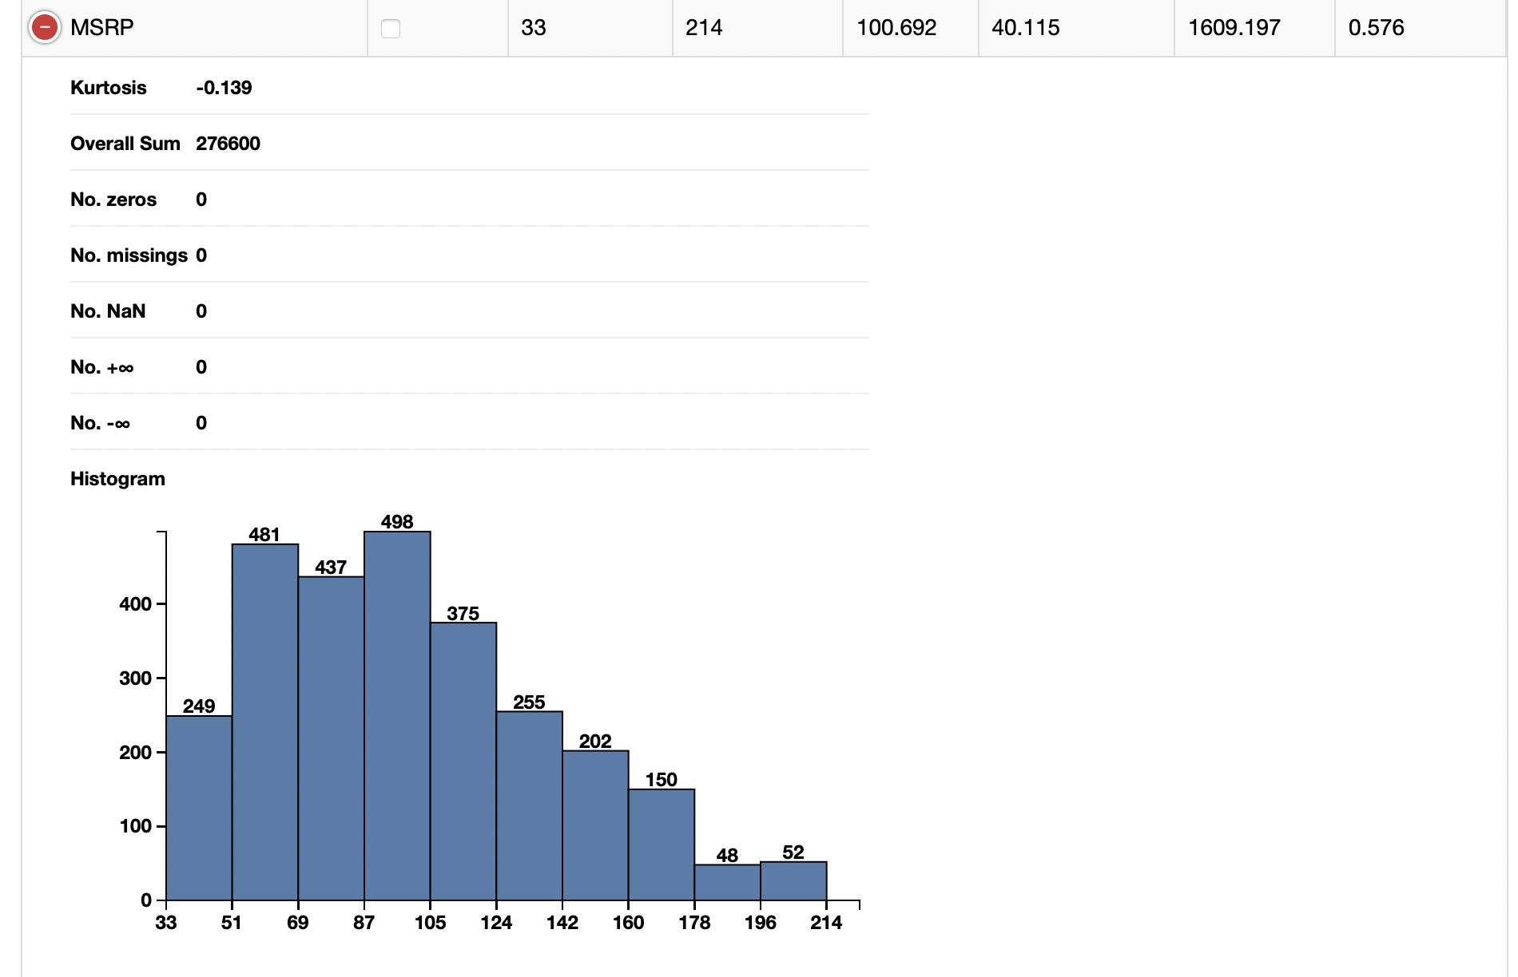

Slide 18
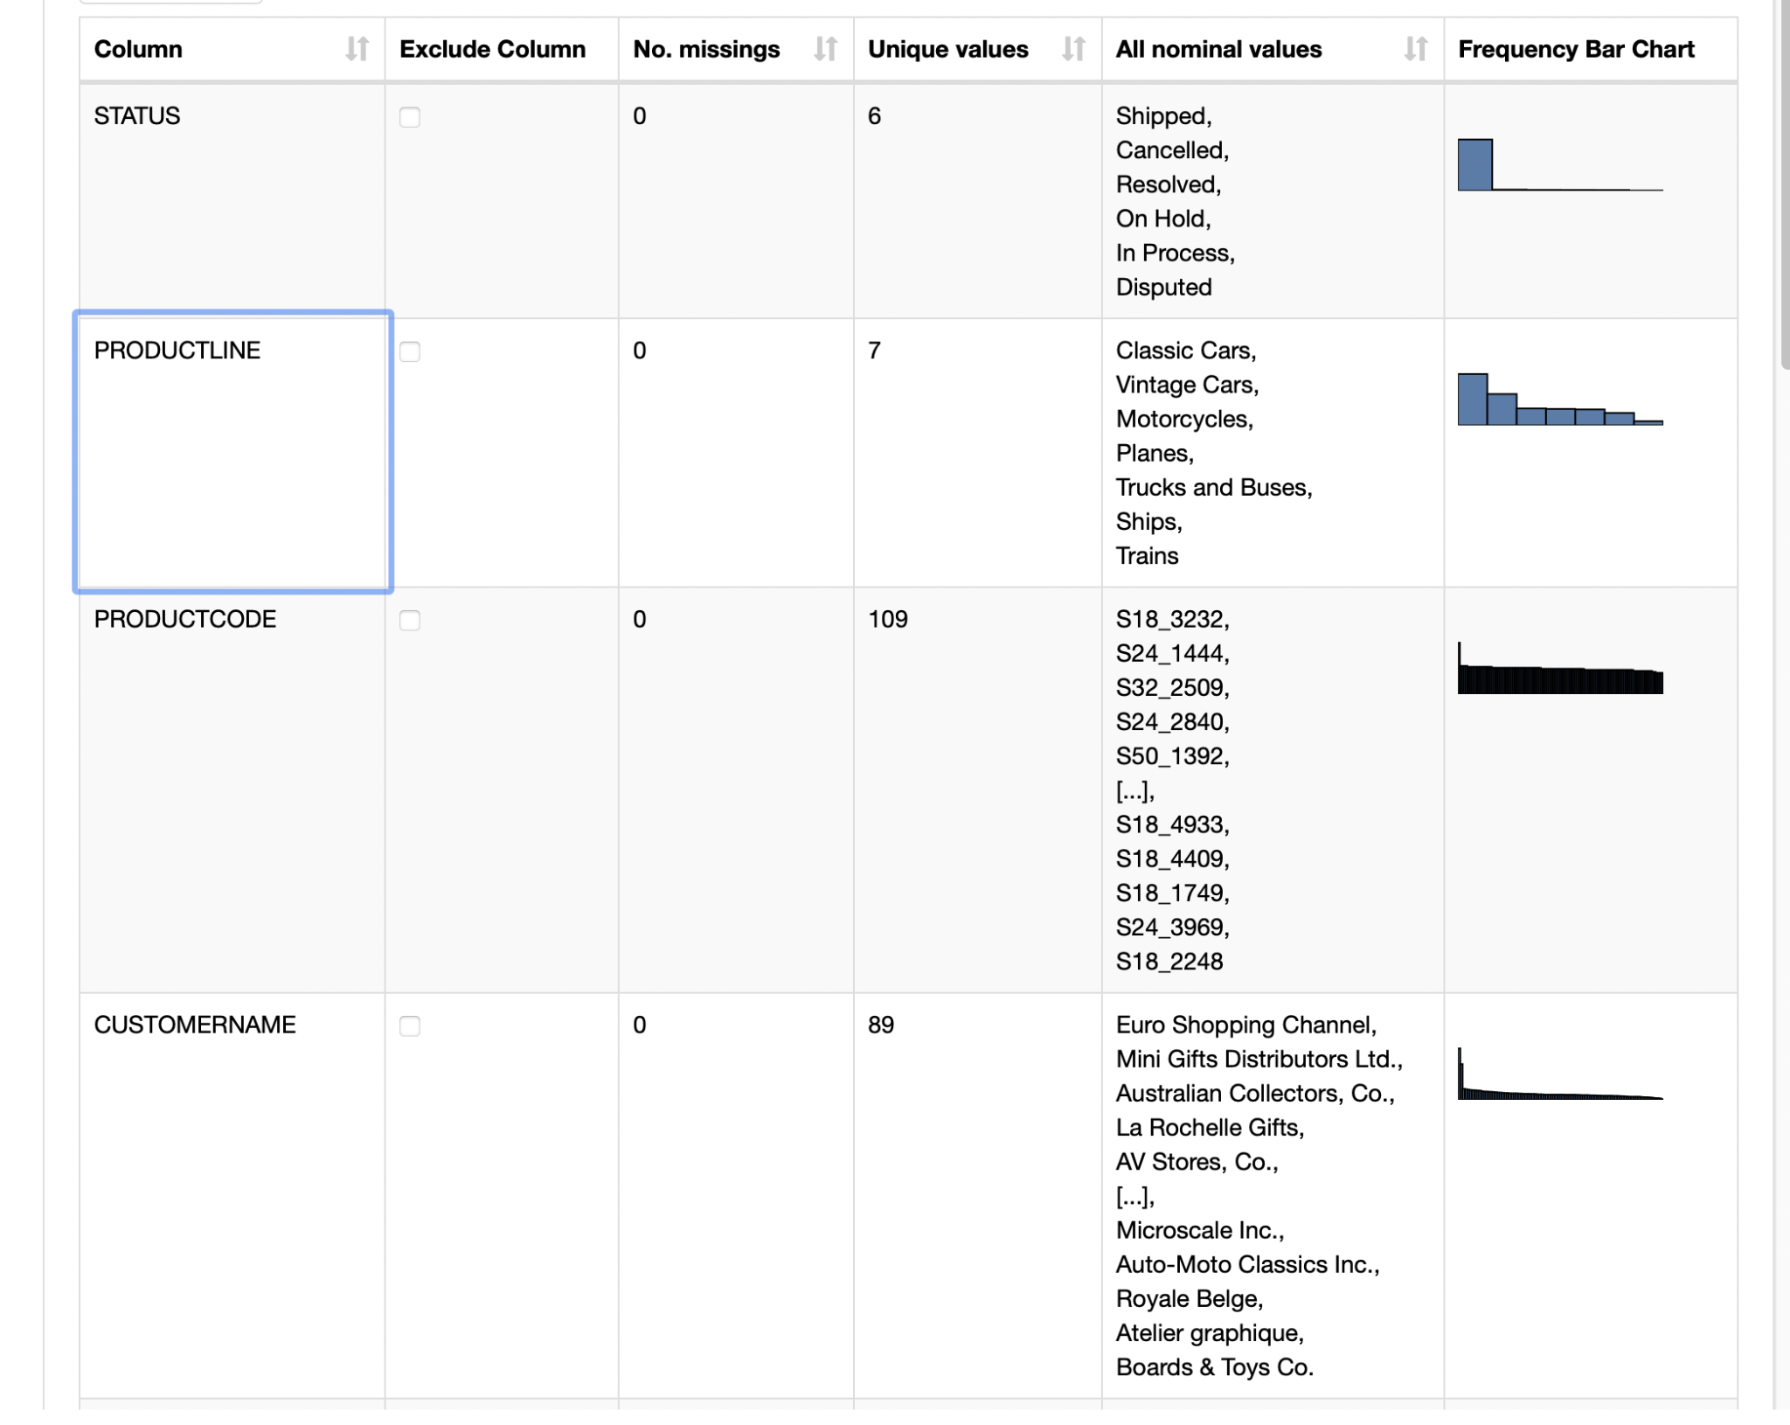

Slide 19
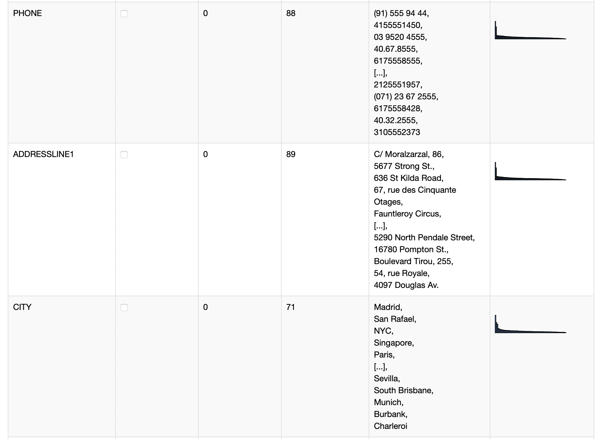
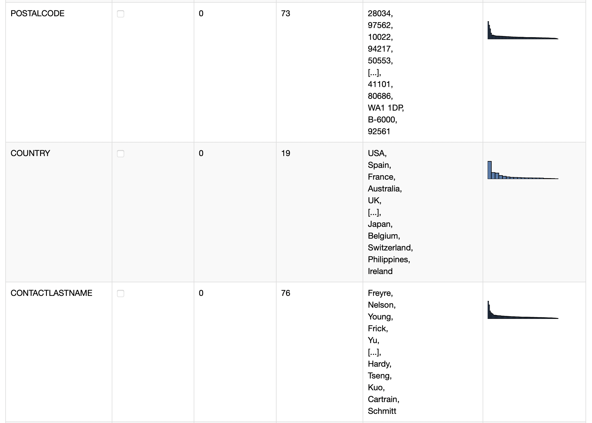
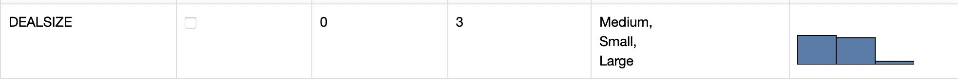

Slide 20
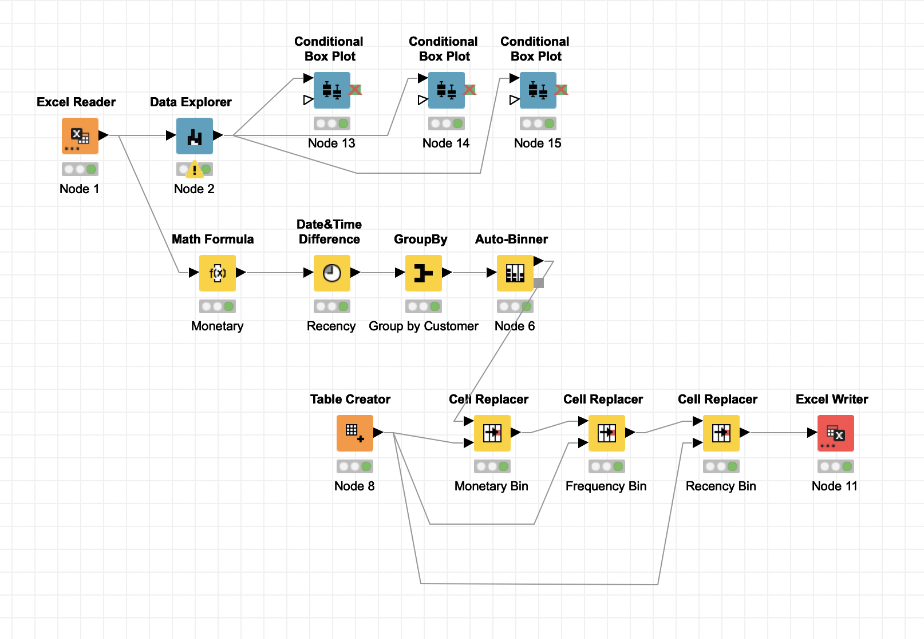
RFM
Customer Segmentation using RFM is made using KNIME.
Segmented as VH (Best Customers),H (Loyal Customers),M (Good Customers), L (Lost/Inactive Customers)
KNIME Workflow:

Slide 21
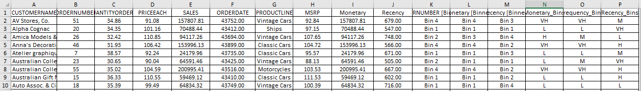
ASSUMPTIONS MADE
CUSTOMERNAME, ORDERLINENUMBER, SALES, STATUS, PRODUCTLINE, MSRP, PRODUCTCODE, ADDRESSLINE1, PHONE, CITY, POSTALCODE, COUNTRY, CONTACTFIRSTNAME, CONTACTLASTNAME, DEALSIZE do not significantly contribute to the RFM Analysis output
Recency = Current Date – Order Date
Frequency = Count of Order number
Monetary = Quantity ordered * Price each
PARAMETERS USED
ORDER NUMBER
QUANTITY ORDERED
PRICE EACH
SALES
ORDER DATE
HEAD OF OUTPUT TABLE

Slide 22
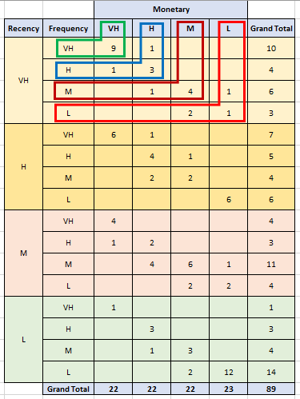
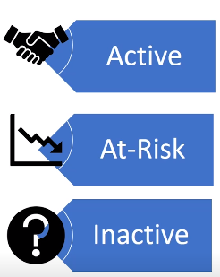
Customers based on segments identified from RFM Analysis
Best customers (VH segment)
Danish Wholesale Imports
Euro Shopping Channel
La Rochelle Gifts
L'ordine Souveniers
Mini Gifts Distributors Ltd
Loyal customers (H segment)
Auto Canal Petit
Tokyo Collectables, Ltd
UK Collectables, Ltd.
Good customers (M segment)
Gifts4AllAges.com
Petit Auto
Quebec Home Shopping Network
Tekni Collectables Inc.
Lost customers (L segment)
Alpha Cognac
Insights from RFM Analysis
Coupons points to reward Best customers
Exclusive Offers to retain Loyal customers
Discounts to retain Good customers
Targeted Marketing strategy to retain Lost customers

